Slide 1
Lab 4 (Java Collections and Generics)
CSE 2200 : Advanced Programming
Google Classroom : https://classroom.google.com/c/Njk2Nzk1NTgwMDA3?cjc=sx63jog
Argha Chandra Dhar
Lecturer,
Dept of CSE, KUET
Email: dhar@cse.kuet.ac.bd
Kazi Saeed Alam
Assistant Professor,
Dept of CSE, KUET
Email: saeed.alam@cse.kuet.ac.bd

Slide 2
Collections
Collections in java is a framework that provides an architecture to store and manipulate the group of objects.
operations like searching, sorting, insertion, manipulation, deletion etc. can be performed by Collections.
Java Collection simply means a single unit of objects.

Slide 3
Collections
Java Collection framework provides many interfaces :
Set, List, Queue, Deque etc.
classes :
ArrayList, Vector, LinkedList, PriorityQueue, HashSet, LinkedHashSet, TreeSet etc.

Slide 4
What is Collection
What is Collection
Collection represents a single unit of objects i.e. a group.
What is Collection framework
Collection framework represents a unified architecture for storing and manipulating group of objects.
It has:Interfaces and its implementations i.e. Classes Algorithm

Slide 5
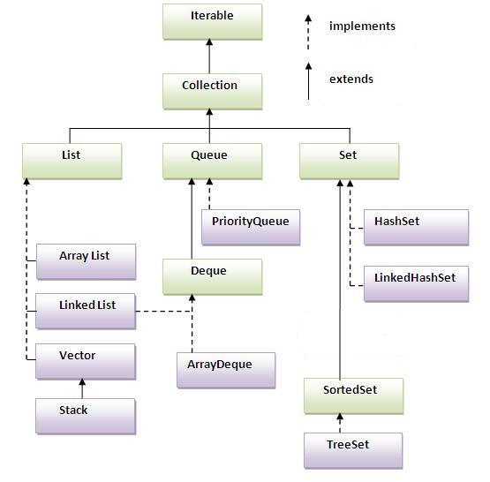
Hierarchy of Collection Framework
The java.util package contains all the classes and interfaces for Collection framework.

Slide 6
Methods of Collection interface
No. | Method | Description
1 | public boolean add(Object element) | is used to insert an element in this collection.
2 | public boolean addAll(collection c) | is used to insert the specified collection elements in the invoking collection.
3 | public boolean remove(Object element) | is used to delete an element from this collection.
4 | public boolean removeAll(Collection c) | is used to delete all the elements of specified collection from the invoking collection.
5 | public boolean retainAll(Collection c) | is used to delete all the elements of invoking collection except the specified collection.
6 | public int size() | return the total number of elements in the collection.
7 | public void clear() | removes the total no of element from the collection.

Slide 7
Methods of Collection interface
No. | Method | Description
8 | public boolean contains(object element) | is used to search an element.
9 | public boolean containsAll(Collection c) | is used to search the specified collection in this collection.
10 | public Iterator iterator() | returns an iterator.
11 | public Object[] toArray() | converts collection into array.
12 | public boolean isEmpty() | checks if collection is empty.
13 | public boolean equals(Object element) | matches two collection.
14 | public int hashCode() | returns the hashcode number for collection.

Slide 8
Methods of Iterator interface
There are only three methods in the Iterator interface. They are:
public boolean hasNext() it returns true if iterator has more elements.
public object next() it returns the element and moves the cursor pointer to the next element.
public void remove() it removes the last elements returned by the iterator. It is rarely used.

Slide 9
Java ArrayList class

Slide 10
ArrayList class
Java ArrayList class uses a dynamic array for storing the elements. It extends AbstractList class and implements List interface.
Java ArrayList class can contain duplicate elements.
Java ArrayList class maintains insertion order.
Java ArrayList class is non synchronized.
Java ArrayList allows random access because array works at the index basis.
In Java ArrayList class, manipulation is slow because a lot of shifting needs to be occurred if any element is removed from the array list.

Slide 11
Example of Java ArrayList class
import java.util.*;
class TestCollection1{
public static void main(String args[]){
ArrayList<String> al=new ArrayList<String>();//creating arraylist
al.add("Ravi");//adding object in arraylist
al.add("Vijay");
al.add("Ravi");
al.add("Ajay");
Iterator itr=al.iterator();//getting Iterator from arraylist to traverse elements
while(itr.hasNext()){
System.out.println(itr.next());
}
}
}
OUTPUT:
Ravi
Vijay
Ravi
Ajay

Slide 12
Methods of ArrayList class
1) add( Object o):
This method adds an object o to the arraylist.
obj.add("hello");
This statement would add a string hello in the arraylist at last position.
2) add(int index, Object o): It adds the object o to the array list at the given index.
obj.add(2, "bye");
It will add the string bye to the 2nd index (3rd position as the array list starts with index 0) of array list.
3) remove(Object o): Removes the object o from the ArrayList.
obj.remove("Chaitanya");
This statement will remove the string “Chaitanya” from the ArrayList.

Slide 13
Methods of ArrayList class
4) remove(int index): Removes element from a given index.
obj.remove(3);
It would remove the element of index 3 (4th element of the list – List starts with o).
5) set(int index, Object o): Used for updating an element. It replaces the element present at the specified index with the object o.
obj.set(2, "Tom");
It would replace the 3rd element (index =2 is 3rd element) with the value Tom.

Slide 14
Methods of ArrayList class
6) int indexOf(Object o): Gives the index of the object o. If the element is not found in the list then this method returns the value -1.
int pos = obj.indexOf("Tom");
This would give the index (position) of the string Tom in the list.
7) Object get(int index): It returns the object of list which is present at the specified index.
String str= obj.get(2);
Function get would return the string stored at 3rd position (index 2).

Slide 15
Methods of ArrayList class
8) int size(): It gives the size of the ArrayList – Number of elements of the list.
int numberofitems = obj.size();
9) boolean contains(Object o): It checks whether the given object o is present in the array list if its there then it returns true else it returns false.
obj.contains("Steve");
10) clear(): It is used for removing all the elements of the array list in one go.
obj.clear();

Slide 16
Iterate the elements of collection
Two ways
By Iterator interface.
By for-each loop.

Slide 17
Iterating the elements of Collection by for-each loop
import java.util.*;
class TestCollection2{
public static void main(String args[]){
ArrayList<String> al=new ArrayList<String>();
al.add("Ravi");
al.add("Vijay");
al.add("Ravi");
al.add("Ajay");
for(String obj:al)
System.out.println(obj);
}
}
OUTPUT:
Ravi
Vijay
Ravi
Ajay

Slide 18
Iterating the elements of Collection by Iterator interface
class Student{
int rollno;
String name;
int age;
Student(int rollno,String name,int age){
this.rollno=rollno;
this.name=name;
this.age=age;
}
}
import java.util.*;
public class TestCollection3{
public static void main(String args[]){
//Creating user-defined class objects
Student s1=new Student(101,"Sonoo",23);
Student s2=new Student(102,"Ravi",21);
Student s2=new Student(103,"Hanumat",25);
ArrayList<Student> al=new ArrayList<Student>();//creating arraylist
al.add(s1);//adding Student class object
al.add(s2);
al.add(s3);
Iterator itr=al.iterator();
//traversing elements of ArrayList object
while(itr.hasNext()){
Student st=(Student)itr.next();
System.out.println(st.rollno+" "+st.name+" "+st.age);
}
}
}
OUTPUT:
101 Sonoo 23
102 Ravi 21
103 Hanumat 25

Slide 19
Example of addAll(Collection c) method
import java.util.*;
class TestCollection4{
public static void main(String args[]){
ArrayList<String> al=new ArrayList<String>();
al.add("Ravi");
al.add("Vijay");
al.add("Ajay");
ArrayList<String> al2=new ArrayList<String>();
al2.add("Sonoo");
al2.add("Hanumat");
al.addAll(al2);
Iterator itr=al.iterator();
while(itr.hasNext()){
System.out.println(itr.next());
}
}
}
OUTPUT:
Ravi
Vijay
Ajay
Sonoo
Hanumat

Slide 20
Loop in ArrayList
//Part 1
import java.util.*;
public class LoopExample {
public static void main(String[] args) {
ArrayList<Integer> arrlist = new ArrayList<Integer>();
arrlist.add(14);
arrlist.add(7);
arrlist.add(39);
arrlist.add(40);
/* For Loop for iterating ArrayList */
System.out.println("For Loop");
for (int counter = 0; counter < arrlist.size(); counter++) {
System.out.println(arrlist.get(counter));
}
/* Advanced For Loop*/
System.out.println("Advanced For Loop");
for (Integer num : arrlist) {
System.out.println(num);
}
//Part 2
/* While Loop for iterating ArrayList*/
System.out.println("While Loop");
int count = 0;
while (arrlist.size() > count) {
System.out.println(arrlist.get(count));
count++;
}
/*Looping Array List using Iterator*/
System.out.println("Iterator");
Iterator iter = arrlist.iterator();
while (iter.hasNext()) {
System.out.println(iter.next());
}
}
}

Slide 21
Example of removeAll() method
import java.util.*;
class TestCollection5{
public static void main(String args[]){
ArrayList<String> al=new ArrayList<String>();
al.add("Ravi");
al.add("Vijay");
al.add("Ajay");
ArrayList<String> al2=new ArrayList<String>();
al2.add("Ravi");
al2.add("Hanumat");
al.removeAll(al2);
System.out.println("iteration after removing the elements of al2...");
Iterator itr=al.iterator();
while(itr.hasNext()){
System.out.println(itr.next());
}
}
}
OUTPUT:
iteration after removing the elements of al2...
Vijay
Ajay

Slide 22
Example of retainAll() method
import java.util.*;
class TestCollection6{
public static void main(String args[]){
ArrayList<String> al=new ArrayList<String>();
al.add("Ravi");
al.add("Vijay");
al.add("Ajay");
ArrayList<String> al2=new ArrayList<String>();
al2.add("Ravi");
al2.add("Hanumat");
al.retainAll(al2);
System.out.println("iterating the elements after retaining the elements of al2...");
Iterator itr=al.iterator();
while(itr.hasNext()){
System.out.println(itr.next());
}
}
}
OUTPUT:
iterating the elements after retaining the elements of al2...
Ravi

Slide 23
Java LinkedList class

Slide 24
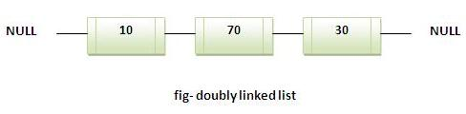
LinkedList class
Java LinkedList class uses doubly linked list to store the elements. It extends the AbstractList class and implements List and Deque interfaces.
Java LinkedList class can contain duplicate elements.
Java LinkedList class maintains insertion order.
Java LinkedList class is non synchronized.
In Java LinkedList class, manipulation is fast because no shifting needs to be occurred.
Java LinkedList class can be used as list, stack or queue.

Slide 25
LinkedList Example
import java.util.*;
public class TestCollection7{
public static void main(String args[]){
LinkedList<String> al=new LinkedList<String>();
al.add("Ravi");
al.add("Vijay");
al.add("Ravi");
al.add("Ajay");
Iterator<String> itr=al.iterator();
while(itr.hasNext()){
System.out.println(itr.next());
}
}
}
Output:Ravi
Vijay
Ravi
Ajay

Slide 26
Difference between ArrayList and LinkedList
ArrayList | LinkedList
1) ArrayList internally uses dynamic array to store the elements. | LinkedList internally uses doubly linked list to store the elements.
2) Manipulation with ArrayList is slow because it internally uses array. If any element is removed from the array, all the bits are shifted in memory. | Manipulation with LinkedList is faster than ArrayList because it uses doubly linked list so no bit shifting is required in memory.
3) ArrayList class can act as a list only because it implements List only. | LinkedList class can act as a list and queue both because it implements List and Deque interfaces.
4) ArrayList is better for storing and accessing data. | LinkedList is better for manipulating data.

Slide 27
Example of ArrayList and LinkedList
import java.util.*;
class TestArrayLinked{
public static void main(String args[]){
List<String> al=new ArrayList<String>();//creating arraylist
al.add("Ravi");//adding object in arraylist
al.add("Vijay");
al.add("Ravi");
al.add("Ajay");
List<String> al2=new LinkedList<String>();//creating linkedlist
al2.add("James");//adding object in linkedlist
al2.add("Serena");
al2.add("Swati");
al2.add("Junaid");
System.out.println("arraylist: "+al);
System.out.println("linkedlist: "+al2);
}
}
OUTPUT:
arraylist: [Ravi,Vijay,Ravi,Ajay]
linkedlist: [James,Serena,Swati,Junaid]

Slide 28
Java List Interface

Slide 29
List Interface
List Interface is the subinterface of Collection. It contains methods to insert and delete elements in index basis.It is a factory of ListIterator interface.

Slide 30
List Interface
Commonly used methods of List Interface:
public void add(int index,Object element);
public boolean addAll(int index,Collection c);
public object get(int Index position);
public object set(int index,Object element);
public object remove(int index);
public ListIterator listIterator();
public ListIterator listIterator(int i);

Slide 31
ListIterator Interface
ListIterator Interface is used to traverse the element in backward and forward direction.
Commonly used methods of ListIterator Interface:
public boolean hasNext();
public Object next();
public boolean hasPrevious();
public Object previous();

Slide 32
Example of ListIterator Interface
import java.util.*;
public class TestCollection8{
public static void main(String args[]){
ArrayList<String> al=new ArrayList<String>();
al.add("Amit");
al.add("Vijay");
al.add("Kumar");
al.add(1,"Sachin");
System.out.println("element at 2nd position: "+al.get(2));
ListIterator<String> itr=al.listIterator();
System.out.println("traversing elements in forward direction...");
while(itr.hasNext()){
System.out.println(itr.next());
}
System.out.println("traversing elements in backward direction...");
while(itr.hasPrevious()){
System.out.println(itr.previous());
}
}
}
Output:
element at 2nd position: Vijay
traversing elements in forward direction...
Amit
Sachin
Vijay
Kumar
traversing elements in backward direction...
Kumar
Vijay
Sachin
Amit

Slide 33
Java HashSet class
Uses hashtable to store the elements.It extends AbstractSet class and implements Set interface.
Contains unique elements only.

Slide 34
About HashSet
HashSet doesn’t maintain any order, the elements would be returned in any random order.
HashSet doesn’t allow duplicates. If you try to add a duplicate element in HashSet, the old value would be overwritten.
HashSet allows null values however if you insert more than one nulls it would still return only one null value.
HashSet is non-synchronized.
.

Slide 35
HashSet Methods
boolean add(Element e): It adds the element e to the list.
void clear(): It removes all the elements from the list.
Object clone(): This method returns a shallow copy of the HashSet.
boolean contains(Object o): It checks whether the specified Object o is present in the list or not. If the object has been found it returns true else false.
boolean isEmpty(): Returns true if there is no element present in the Set.
int size(): It gives the number of elements of a Set.
boolean remove(Object o): It removes the specified Object o from the Set.

Slide 36
Difference between List and Set
List can contain duplicate elements whereas Set contains unique elements only.

Slide 37
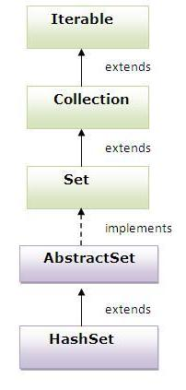
Hierarchy of HashSet class

Slide 38
Example of HashSet class
import java.util.*;
class TestCollection9{
public static void main(String args[]){
HashSet<String> al=new HashSet<String>();
al.add("Ravi");
al.add("Vijay");
al.add("Ravi");
al.add("Ajay");
Iterator<String> itr=al.iterator();
while(itr.hasNext()){
System.out.println(itr.next());
}
}
}
Output:
Ajay
Vijay
Ravi

Slide 39
Java LinkedHashSet class
Contains unique elements only like HashSet. It extends HashSet class and implements Set interface.
LinkedHashSet maintains the insertion order.

Slide 40
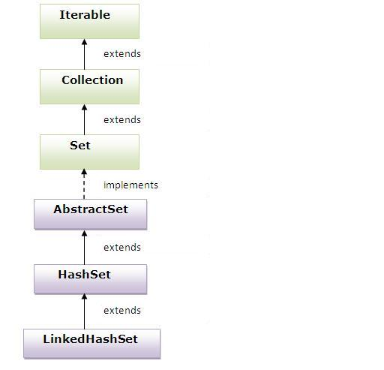
Hierarchy of LinkedHashSet

Slide 41
Example of LinkedHashSet
import java.util.*;
class TestCollection10{
public static void main(String args[]){
LinkedHashSet<String> al=new LinkedHashSet<String>();
al.add("Ravi");
al.add("Vijay");
al.add("Ravi");
al.add("Ajay");
Iterator<String> itr=al.iterator();
while(itr.hasNext()){
System.out.println(itr.next());
}
}
}
Output:
Ravi
Vijay
Ajay

Slide 42
Java TreeSet class
Contains unique elements only like HashSet. The TreeSet class implements NavigableSet interface that extends the SortedSet interface.
TreeSet sorts the elements in ascending order

Slide 43
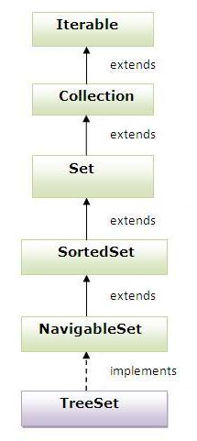
Hierarchy of TreeSet class

Slide 44
Example of TreeSet class
import java.util.*;
class TestCollection11{
public static void main(String args[]){
TreeSet<String> al=new TreeSet<String>();
al.add("Ravi");
al.add("Vijay");
al.add("Ravi");
al.add("Ajay");
Iterator<String> itr=al.iterator();
while(itr.hasNext()){
System.out.println(itr.next());
}
}
}
Output:
Ajay
Ravi
Vijay

Slide 45
HashSet, LinkedHashSet, TreeSet
HashSet doesn’t maintain any kind of order of its elements.
TreeSet sorts the elements in ascending order.
LinkedHashSet maintains the insertion order. Elements gets sorted in the same sequence in which they have been added to the Set.

Slide 46
Java Queue Interface
The Queue interface basically orders the element in FIFO(First In First Out)manner.
Methods of Queue Interface :
public boolean add(object); //add elements at the tail of queue
public remove(); //removes and returns the head of the queue.
public poll(); //removes and returns the head of the queue.
public element(); //similar to peek().
public peek(); //This method is used to view the head of queue without removing it.

Slide 47
PriorityQueue class
The PriorityQueue class provides the facility of using queue. But it does not orders the elements in FIFO manner.
The elements of the priority queue are ordered according to their natural ordering, or by a Comparator provided at queue construction time, depending on which constructor is used.

Slide 48
Example of PriorityQueue
import java.util.*;
class TestCollection12{
public static void main(String args[]){
PriorityQueue<String> queue=new PriorityQueue<String>();
queue.add("Amit");
queue.add("Vijay");
queue.add("Karan");
queue.add("Jai");
queue.add("Rahul");
System.out.println("head:"+queue.element());
System.out.println("head:"+queue.peek());
System.out.println("iterating the queue elements:");
Iterator itr=queue.iterator();
while(itr.hasNext()){
System.out.println(itr.next());
}
queue.remove();
queue.poll();
System.out.println("after removing two elements:");
Iterator<String> itr2=queue.iterator();
while(itr2.hasNext()){
System.out.println(itr2.next());
} } }
Output:head:Amit
head:Amit
iterating the queue elements:
Amit
Jai
Karan
Vijay
Rahul
after removing two elements:
Karan
Rahul
Vijay

Slide 49
Java Map Interface
A map contains values based on the key i.e. key and value pair. Each pair is known as an entry. Map contains only unique elements.
Commonly used methods of Map interface:
public Object put(object key,Object value): is used to insert an entry in this map.
public void putAll(Map map):is used to insert the specified map in this map.
public Object remove(object key):is used to delete an entry for the specified key.
public Object get(Object key):is used to return the value for the specified key.
public boolean containsKey(Object key):is used to search the specified key from this map.
public boolean containsValue(Object value):is used to search the specified value from this map.
public Set keySet():returns the Set view containing all the keys.
public Set entrySet():returns the Set view containing all the keys and values.

Slide 50
Map Interface
Methods of Entry interface:
public Object getKey(): is used to obtain key.
public Object getValue():is used to obtain value.

Slide 51
Java HashMap class
A HashMap contains values based on the key. It implements the Map interface and extends AbstractMap class.
It contains only unique elements.
It may have one null key and multiple null values.
It maintains no order.

Slide 52
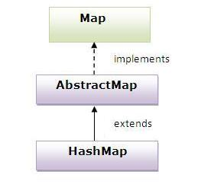
Hierarchy of HashMap class

Slide 53
HashMap Class Methods
void clear(): It removes all the key and value pairs.
Object clone(): It returns a copy of all the mappings of a map and used for cloning them into another map.
boolean containsKey(Object key): It returns true or false based on whether the specified key is found in the map.
boolean containsValue(Object Value): Similar to containsKey() method, however it looks for the specified value instead of key.
Value get(Object key): It returns the value for the specified key.
boolean isEmpty(): It checks whether the map is empty.
Set keySet(): It returns the Set of the keys fetched from the map.
value put(Key k, Value v): Inserts key value mapping into the map.
int size(): Returns the size of the map
Collection values(): It returns a collection of values of map.
Value remove(Object key): It removes the key-value pair
void putAll(Map m): Copies all the elements of a map to the another specified map.

Slide 54
Example of HashMap class
import java.util.*;
class TestCollection13{
public static void main(String args[]){
HashMap<Integer,String> hm=new HashMap<Integer,String>();
hm.put(100,"Amit");
hm.put(101,"Vijay");
hm.put(102,"Rahul");
for(Map.Entry m:hm.entrySet()){
System.out.println(m.getKey()+" "+m.getValue());
}
}
}
Output:102 Rahul
100 Amit
101 Vijay

Slide 55
Example of HashMap class
//Part 1
import java.util.HashMap;
import java.util.Map;
import java.util.Iterator;
import java.util.Set;
public class Details {
public static void main(String args[]) {
/* This is how to declare HashMap */
HashMap<Integer, String> hmap = new HashMap<Integer, String>();
/*Adding elements to HashMap*/
hmap.put(12, "Chaitanya");
hmap.put(2, "Rahul");
hmap.put(7, "Singh");
hmap.put(49, "Ajeet");
hmap.put(3, "Anuj");
/* Display content using Iterator*/
Set set = hmap.entrySet();
Iterator iterator = set.iterator();
while(iterator.hasNext()) {
Map.Entry mentry = (Map.Entry)iterator.next();
System.out.print("key is: "+ mentry.getKey() + " & Value is: ");
System.out.println(mentry.getValue());
}
//Part 2
/* Get values based on key*/
String var= hmap.get(2);
System.out.println("Value at index 2 is: "+var);
/* Remove values based on key*/
hmap.remove(3);
System.out.println("Map key and values after removal:");
Set set2 = hmap.entrySet();
Iterator iterator2 = set2.iterator();
while(iterator2.hasNext()) {
Map.Entry mentry2 = (Map.Entry)iterator2.next();
System.out.print("Key is: "+mentry2.getKey() + " & Value is: ");
System.out.println(mentry2.getValue());
}
}
}

Slide 56
What is difference between HashSet and HashMap?
HashSet contains only values
whereas HashMap contains entry(key and value).

Slide 57
LinkedHashMap class
A LinkedHashMap contains values based on the key. It implements the Map interface and extends HashMap class.
It contains only unique elements.
It may have one null key and multiple null values.
It maintains insertion order.

Slide 58
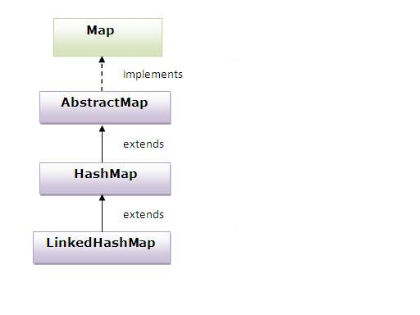
Hierarchy of LinkedHashMap class

Slide 59
Example of LinkedHashMap
import java.util.*;
class TestCollection14{
public static void main(String args[]){
LinkedHashMap<Integer,String> hm=new LinkedHashMap<Integer,String>();
hm.put(100,"Amit");
hm.put(102,"Vijay");
hm.put(101,"Rahul");
for(Map.Entry m:hm.entrySet()){
System.out.println(m.getKey()+" "+m.getValue());
}
}
}
Output:100 Amit
102 Vijay
101 Rahul

Slide 60
Java TreeMap class
A TreeMap contains values based on the key. It implements the NavigableMap interface and extends AbstractMap class.
It contains only unique elements.
It cannot have null key but can have multiple null values.
Elements will be sorted in ascending key order

Slide 61
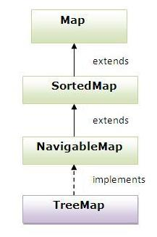
Hierarchy of TreeMap class

Slide 62
Example of TreeMap
import java.util.*;
class TestCollection15{
public static void main(String args[]){
TreeMap<Integer,String> hm=new TreeMap<Integer,String>();
hm.put(100,"Amit");
hm.put(102,"Ravi");
hm.put(101,"Vijay");
hm.put(103,"Rahul");
for(Map.Entry m:hm.entrySet()){
System.out.println(m.getKey()+" "+m.getValue());
}
}
}
Output:100 Amit
101 Vijay
102 Ravi
103 Rahul

Slide 63
What is difference between HashMap and TreeMap?
1) HashMap is can contain one null key. | TreeMap can not contain any null key.
2) HashMap maintains no order. | TreeMap maintains ascending order.

Slide 64
Sorting List elements
public void sort(List list): is used to sort the elements of List
// Example of Sorting the elements of List that contains string objects
import java.util.*;
class TestSort1{
public static void main(String args[]){
ArrayList<String> al=new ArrayList<String>();
al.add("Viru");
al.add("Saurav");
al.add("Mukesh");
al.add("Tahir");
Collections.sort(al);
Iterator itr=al.iterator();
while(itr.hasNext()){
System.out.println(itr.next());
}
}
}
Output:Mukesh
Saurav
Tahir
Viru

Slide 65
Comparable interface
Comparable interface is used to order the objects of user-defined class.
This interface is found in java.lang package and contains only one method named compareTo(Object).
It provide only single sorting sequence i.e. you can sort the elements on based on single datamember only. For instance it may be either rollno,name,age or anything else.

Slide 66
Comparable interface
Syntax:
public int compareTo(Object obj): is used to compare the current object with the specified object.
We can sort the elements of:
String objects
Wrapper class objects
User-defined class objects

Slide 67
Comparable interface
Collections class provides static methods for sorting the elements of collection.If collection elements are of Set type, we can use TreeSet. But We cannot sort the elements of List.Collections class provides methods for sorting the elements of List type elements.
Method of Collections class for sorting:
public void sort(List list): is used to sort the elements of List.List elements must be of Comparable type.

Slide 68
Sorting List elements that contains user-defined objects
//Save as Student.java
class Student implements Comparable{
int rollno;
String name;
int age;
Student(int rollno,String name,int age){
this.rollno=rollno;
this.name=name;
this.age=age;
}
public int compareTo(Object obj){
Student st=(Student)obj;
if(age==st.age)
return 0;
else if(age>st.age)
return 1;
else km
return -1;
} }
// Save as Simple.java
import java.util.*;
import java.io.*;
class TestSort3{
public static void main(String args[]){
ArrayList al=new ArrayList();
al.add(new Student(101,"Vijay",23));
al.add(new Student(106,"Ajay",27));
al.add(new Student(105,"Jai",21));
Collections.sort(al);
Iterator itr=al.iterator();
while(itr.hasNext()){
Student st=(Student)itr.next();
System.out.println(st.rollno+""+st.name+""+st.age);
}
}
}
Output:105 Jai 21
101 Vijay 23
106 Ajay 27

Slide 69
Comparator interface
Comparator interface is used to order the objects of user-defined class.
This interface is found in java.util package and contains 2 methods compare(Object obj1,Object obj2) and equals(Object element).
It provides multiple sorting sequence i.e. you can sort the elements based on any data member. For instance it may be on rollno, name, age or anything else.

Slide 70
Method of Collections class for sorting List elements
public void sort(List list,Comparator c): is used to sort the elements of List by the given comparator.

Slide 71
Example of Sorting List that contains user-defined objects
//Student.java
class Student{
int rollno;
String name;
int age;
Student(int rollno,String name,int age){
this.rollno=rollno;
this.name=name;
this.age=age;
}
}
//AgeComparator.java
import java.util.*;
class AgeComparator implements Comparator{
public int Compare(Object o1,Object o2){
Student s1=(Student)o1;
Student s2=(Student)o2;
if(s1.age==s2.age) return 0;
else if(s1.age>s2.age) return 1;
else return -1;
} }
//NameComparator.java
import java.util.*;
class NameComparator implements Comparator{
public int Compare(Object o1,Object o2){
Student s1=(Student)o1;
Student s2=(Student)o2;
return s1.name.compareTo(s2.name);
}
}

Slide 72
Continue….
import java.util.*;
import java.io.*;
class Simple{
public static void main(String args[]){
ArrayList al=new ArrayList();
al.add(new Student(101,"Vijay",23));
al.add(new Student(106,"Ajay",27));
al.add(new Student(105,"Jai",21));
System.out.println("Sorting by Name...");
Collections.sort(al,new NameComparator());
Iterator itr=al.iterator();
while(itr.hasNext()){
Student st=(Student)itr.next();
System.out.println(st.rollno+" "+st.name+" "+st.age); }
System.out.println("sorting by age...");
Collections.sort(al,new AgeComparator());
Iterator itr2=al.iterator();
while(itr2.hasNext()){
Student st=(Student)itr2.next();
System.out.println(st.rollno+" "+st.name+" "+st.age);
} } }
Output:Sorting by Name...
106 Ajay 27
105 Jai 21
101 Vijay 23
Sorting by age...
105 Jai 21
101 Vijay 23
106 Ajay 27

Slide 73
import java.util.Comparator;
public class Student {
private String studentname;
private int rollno;
private int studentage;
Student(int rollno, String studentname, int studentage) {
this.rollno = rollno;
this.studentname = studentname;
this.studentage = studentage;
}
...
//Getter and setter methods same as the above examples
...
/*Comparator for sorting the list by Student Name*/
public static Comparator<Student> StuNameComparator = new Comparator<Student>() {
public int compare(Student s1, Student s2) {
String StudentName1 = s1.getStudentname().toUpperCase();
String StudentName2 = s2.getStudentname().toUpperCase();
return StudentName1.compareTo(StudentName2); //ascending order
//return StudentName2.compareTo(StudentName1); //descending order
}};
/*Comparator for sorting the list by roll no*/
public static Comparator<Student> StuRollno = new Comparator<Student>() {
public int compare(Student s1, Student s2) {
int rollno1 = s1.getRollno();
int rollno2 = s2.getRollno();
return rollno1-rollno2; /*For ascending order*/
//rollno2-rollno1; /*For descending order*/
}};
@Override
public String toString() {
return "[ rollno=" + rollno + ", name=" + studentname + ", age=" + studentage + "]";
}
}

Slide 74
Sorting ArrayList<Object> multiple properties with Comparator
import java.util.*;
public class Details {
public static void main(String args[]){
ArrayList<Student> arraylist = new ArrayList<Student>();
arraylist.add(new Student(101, "Zues", 26));
arraylist.add(new Student(505, "Abey", 24));
arraylist.add(new Student(809, "Vignesh", 32));
/*Sorting based on Student Name*/
System.out.println("Student Name Sorting:");
Collections.sort(arraylist, Student.StuNameComparator);
for(Student str: arraylist){
System.out.println(str);
}
/* Sorting on Rollno property*/
System.out.println("RollNum Sorting:");
Collections.sort(arraylist, Student.StuRollno);
for(Student str: arraylist){
System.out.println(str);
}
}
}

Slide 75
The Vector Class
Vector implements a dynamic array. It is similar to ArrayList, but with two differences:
Vector is synchronized.
Vector contains many legacy methods that are not part of the collections framework.

Slide 76
Some Methods of Vector class
void add(int index, Object element)
boolean addAll(Collection c)
boolean addAll(int index, Collection c)
void addElement(Object obj)
int capacity()
void clear()
Object clone()
boolean contains(Object elem)
boolean containsAll(Collection c)
void copyInto(Object[] anArray)
Object elementAt(int index)

Slide 77
Example of Vector
import java.util.*;
public class VectorExample {
public static void main(String args[]) {
/* Vector of initial capacity(size) of 2 */
Vector<String> vec = new Vector<String>(2);
/* Adding elements to a vector*/
vec.addElement("Apple");
vec.addElement("Orange");
vec.addElement("Mango");
vec.addElement("Fig");
/* check size and capacityIncrement*/
System.out.println("Size is: "+vec.size());
System.out.println("Default capacity increment is: "+vec.capacity());
vec.addElement("fruit1");
vec.addElement("fruit2");
vec.addElement("fruit3");
/*size and capacityIncrement after two insertions*/
System.out.println("Size after addition: "+vec.size());
System.out.println("Capacity after increment is: "+vec.capacity());
/*Display Vector elements*/
Iterator itr=vec.iterator();
while(vec.hasNext()){
System.out.print(vec.next() + " ");
}
}

Slide 78
similarities between ArrayList and Vector
Both Vector and ArrayList use growable array data structure.
They both are ordered collection classes as they maintain the elements insertion order.
Vector & ArrayList both allows duplicate and null values.
They both grows and shrinks automatically when overflow and deletion happens.

Slide 79
Difference between ArrayList and Vector
ArrayList | Vector
1) ArrayList is not synchronized. | Vector is synchronized.
2) ArrayList increments 50% of current array size if number of element exceeds from its capacity. | Vector increments 100% means doubles the array size if total number of element exceeds than its capacity.
3) ArrayList is not a legacy class | Vector is a legacy class.
4) ArrayList is fast because it is non-synchronized. | Vector is slow because it is synchronized i.e. in multithreading environment, it will hold the other threads in runnable or non-runnable state until current thread releases the lock of object.

Slide 80
When to use ArrayList and when to use vector?
Synchronized operations consumes more time compared to non-synchronized ones so if there is no need for thread safe operation, ArrayList is a better choice as performance will be improved because of the concurrent processes.

Slide 81
Summary
Java ArrayList class can contain duplicate elements.
Java ArrayList class maintains insertion order.
Java ArrayList class is non synchronized.
-----------------------------------------------------------
LinkedList class can contain duplicate elements.
LinkedList class maintains insertion order.
LinkedList class is non synchronized.
-------------------------------------------
HashSet maintain no order
HashSet Contains unique elements only.
HashSet is not synchronized
HashSet contains only values not key

Slide 82
Summary
LinkedHashSet maintains the insertion order
LinkedHashSet Contains unique elements
------------------------------------------------------
TreeSet Contains unique elements
TreeSet sorts the elements in ascending order
--------------------------------------------------------
priority queue are ordered according to their natural ordering
------------------------------------------------------------
HashMap contains values based on the key
It contains only unique elements
It maintains no order.
HashMap contains entry(key and value).
not synchronized

Slide 83
Summary
LinkedHashMap contains only unique elements
LinkedHashMap contains values based on the key
It contains only unique elements.
It maintains insertion order
--------------------------------------------------------------------------
TreeMap contains only unique elements
Elements will be sorted in ascending key order
TreeMap contains values based on the key
-----------------------------------------------------------------------------
Hashtable is an array of list. Each list is known as a bucket.The position of bucket is identified by calling the hashcode() method.
It contains only unique elements.
It is synchronized.

Slide 84
Generics

Slide 85
Generics in Java
The Java Generics programming is introduced in J2SE 5 to deal with type-safe objects.
Before generics, we can store any type of objects in collection i.e. non-generic

Slide 86
Non-generic Vs Generic Collection
Java new generic collection allows you to have only one type of object in collection. Now it is type safe so typecasting is not required at run time.
Let's see the old non-generic example of creating java collection.
ArrayList al=new ArrayList();//creating old non-generic arraylist
Let's see the new generic example of creating java collection.
ArrayList<String> al=new ArrayList<String>();//creating new generic arraylist
In generic collection, we specify the type in angular braces. Now ArrayList is forced to have only specified type of objects in it. If you try to add another type of object, it gives compile time error.

Slide 87
Advantage of Java Generics
There are mainly 3 advantages of generics. They are as follows:
1) Type-safety : We can hold only a single type of objects in generics. It doesn’t allow to store other objects.

Slide 88
Advantage of Java Generics (Cont..)
2) Type casting is not required: There is no need to typecast the object.
Before Generics, we need to type cast.
List list = new ArrayList();
list.add("hello");
String s = (String) list.get(0);//typecasting
After Generics, we don't need to typecast the object.
List<String> list = new ArrayList<String>();
list.add("hello");
String s = list.get(0);

Slide 89
Advantage of Java Generics (Cont..)
3) Compile-Time Checking: It is checked at compile time so problem will not occur at runtime. The good programming strategy says it is far better to handle the problem at compile time than runtime.
List<String> list = new ArrayList<String>();
list.add("hello");
list.add(32);//Compile Time Error

Slide 90
Generics
Syntax to use generic collection
ClassOrInterface<Type>
Example to use Generics in java
ArrayList<String>

Slide 91
Example of Generics using ArrayList
import java.util.*;
class TestGenerics1{
public static void main(String args[]){
ArrayList<String> list=new ArrayList<String>();
list.add("rahul");
list.add("jai");
//list.add(32);//compile time error
String s=list.get(1);//type casting is not required
System.out.println("element is: "+s);
Iterator<String> itr=list.iterator();
while(itr.hasNext()){
System.out.println(itr.next());
}
}
}
Output:element is: jai
rahul
jai

Slide 92
Example of Generics using Map
import java.util.*;
class TestGenerics2{
public static void main(String args[]){
Map<Integer,String> map=new HashMap<Integer,String>();
map.put(1,"vijay");
map.put(4,"umesh");
map.put(2,"ankit");
//Now use Map.Entry for Set and Iterator
Set<Map.Entry<Integer,String>> set=map.entrySet();
Iterator<Map.Entry<Integer,String>> itr=set.iterator();
while(itr.hasNext()){
Map.Entry e=itr.next();//no need to typecast
System.out.println(e.getKey()+" "+e.getValue());
}
}}
Output:1 vijay
2 ankit
4 umesh

Slide 93
Generic class
A class that can refer to any type is known as generic class. Here, we are using T type parameter to create the generic class of specific type.
Example:
Creating generic class:
class MyGen<T>{
T obj;
void add(T obj){this.obj=obj;}
T get(){return obj;}
}
The T type indicates that it can refer to any type (like String, Integer, Employee etc.). The type you specify for the class, will be used to store and retrieve the data.

Slide 94
Generic class
Using the generic class:
Let’s see the code to use the generic class.
class TestGenerics3{
public static void main(String args[]){
MyGen<Integer> m=new MyGen<Integer>();
m.add(2);
//m.add("vivek");//Compile time error
System.out.println(m.get());
}
}
Output: 2

Slide 95
Type Parameters in Generic
The type parameters naming conventions are important to learn generics thoroughly. The commonly type parameters are as follows:
T - Type
E - Element
K - Key
N - Number
V - Value

Slide 96
Generic Method
Like generic class, we can create generic method that can accept any type of argument.
Example of generic method to print array elements. We are using here E to denote the element.
public class TestGenerics4{
public static < E > void printArray(E[] elements) {
for ( E element : elements){
System.out.println(element );
}
System.out.println();
}
public static void main( String args[] ) {
Integer[] intArray = { 10, 20, 30, 40, 50 };
Character[] charArray = { 'J', 'A', 'V', 'A', 'T','P','O','I','N','T' };
System.out.println( "Printing Integer Array" );
printArray( intArray );
System.out.println( "Printing Character Array" );
printArray( charArray );
}
}
Output:
Printing Integer Array
10
20
30
40
50
Printing Character Array
J
A
V
A
T
P
O
I
N
T

Slide 97
Wildcard in Java Generics
The ? (question mark) symbol represents wildcard element. It means any type. If we write <? extends Number>, it means any child class of Number e.g. Integer, Float, double etc. Now we can call the method of Number class through any child class object.
Example:.................

Slide 98
Wildcard in Java Generics
import java.util.*;
abstract class Shape{
abstract void draw();
}
class Rectangle extends Shape{
void draw(){System.out.println("drawing rectangle");}
}
class Circle extends Shape{
void draw(){System.out.println("drawing circle");}
}
class GenericTest{
//creating a method that accepts only child class of Shape
public static void drawShapes(List<? extends Shape> lists){
for(Shape s:lists){
s.draw();//calling method of Shape class by child class instance
}
}
public static void main(String args[]){
List<Rectangle> list1=new ArrayList<Rectangle>();
list1.add(new Rectangle());
List<Circle> list2=new ArrayList<Circle>();
list2.add(new Circle());
list2.add(new Circle());
drawShapes(list1);
drawShapes(list2);
}}
OUTPUT:
drawing rectangle drawing circle drawing circle

Slide 99
File Handling in Java

Slide 100
File Handling in Java
File Handling in java is an important part of any application.
The File class from the java.io package, allows us to work with files.
To use the File class, create an object of the class, and specify the filename or directory name.

Slide 101

File Handling in Java
Java File class represents the files and directory pathnames in an abstract manner.
This class is used for creation of files and directories, file searching, file deletion, etc.
The File object represents the actual file/directory on the disk.

Slide 102
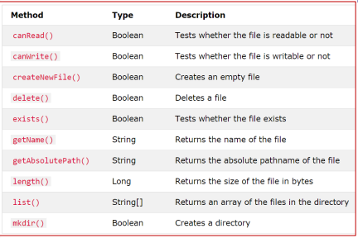
File Class Methods

Slide 103

Writing File to a Specific Directory
To create a file in a specific directory (requires permission), specify the path of the file and use double backslashes to escape the "\" character (for Windows).
On Mac and Linux you can just write the path, like: /Users/name/filename.txt

Slide 104
Write to a File
In the following example, we use the FileWriter class together with its write() method to write some text to the file we created in the example above.
Note that when you are done writing to the file, you should close it with the close() method.

Slide 105
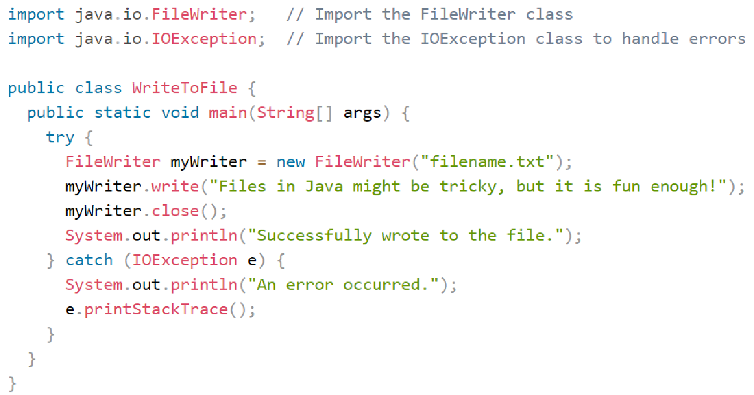
Write to a File

Slide 106
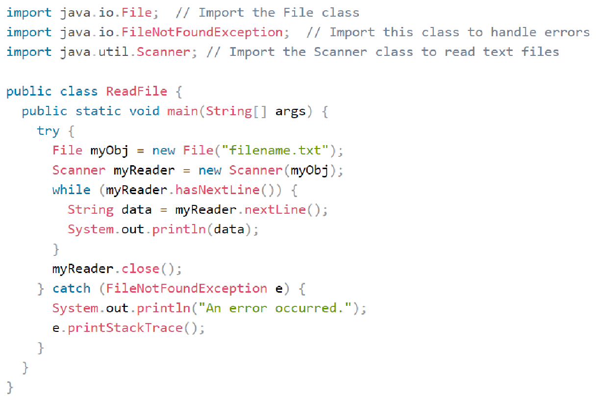
Read a File
In the following example, we use the Scanner class to read the contents of the text file.

Slide 107
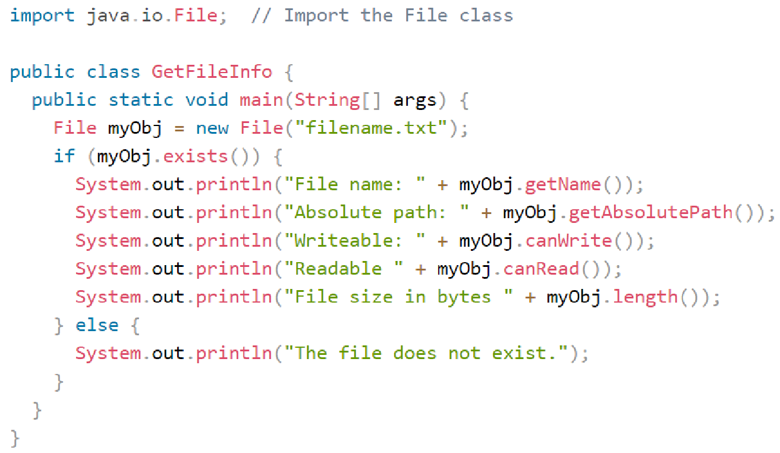
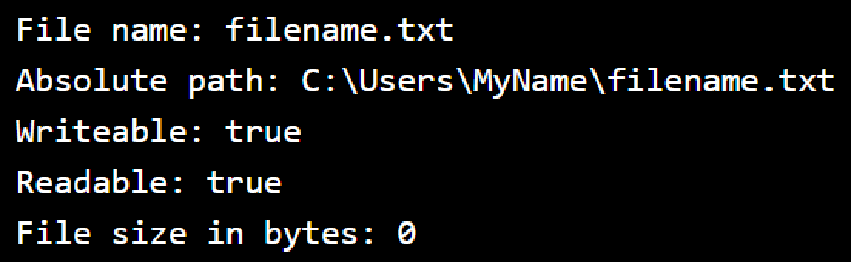
Getting File Information
To get more information about a file, use any of the File methods:

Slide 108
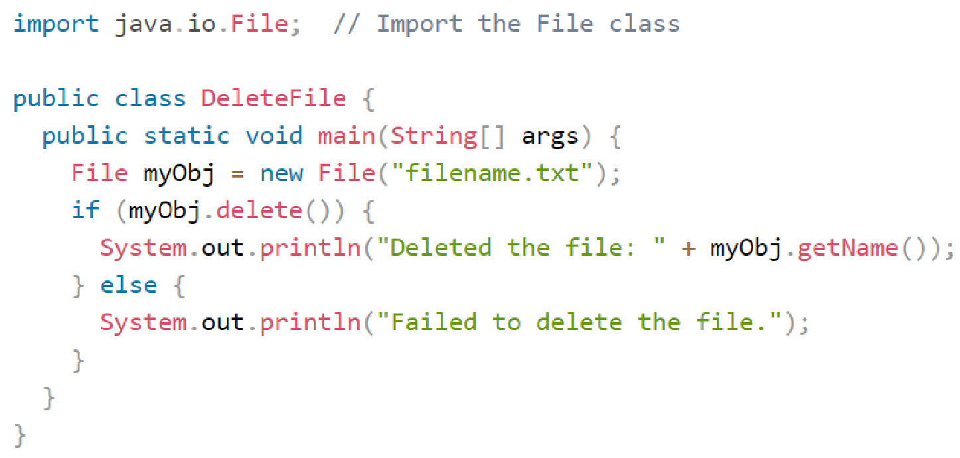

Deleting a File

Slide 109
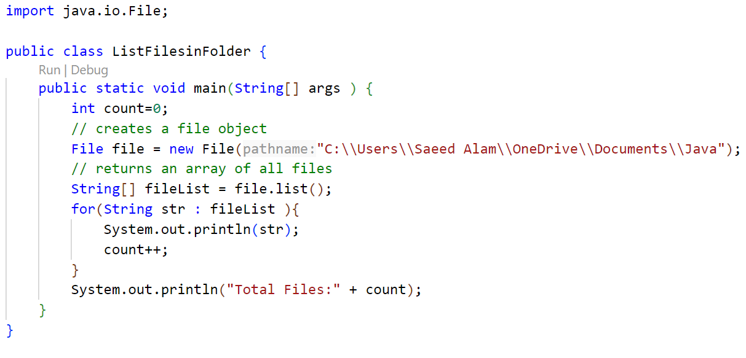
Listing all files in a Folder
Lab1
Lab2
Lab3
Lab4
Thread.ppt
Java.pdf

Slide 110
File Input Stream
A FileInputStream obtains input bytes from a file in a file system.
What files are available depends on the host environment.
FileInputStream is meant for reading streams of raw bytes such as image data.
For reading streams of characters, consider using FileReader.

Slide 111
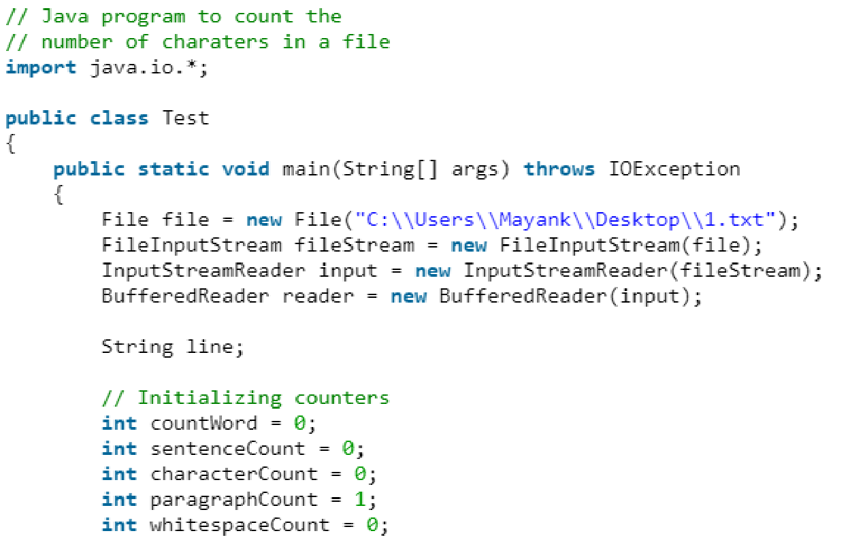
Example Task
Counting Number of Characters in a file

Slide 112
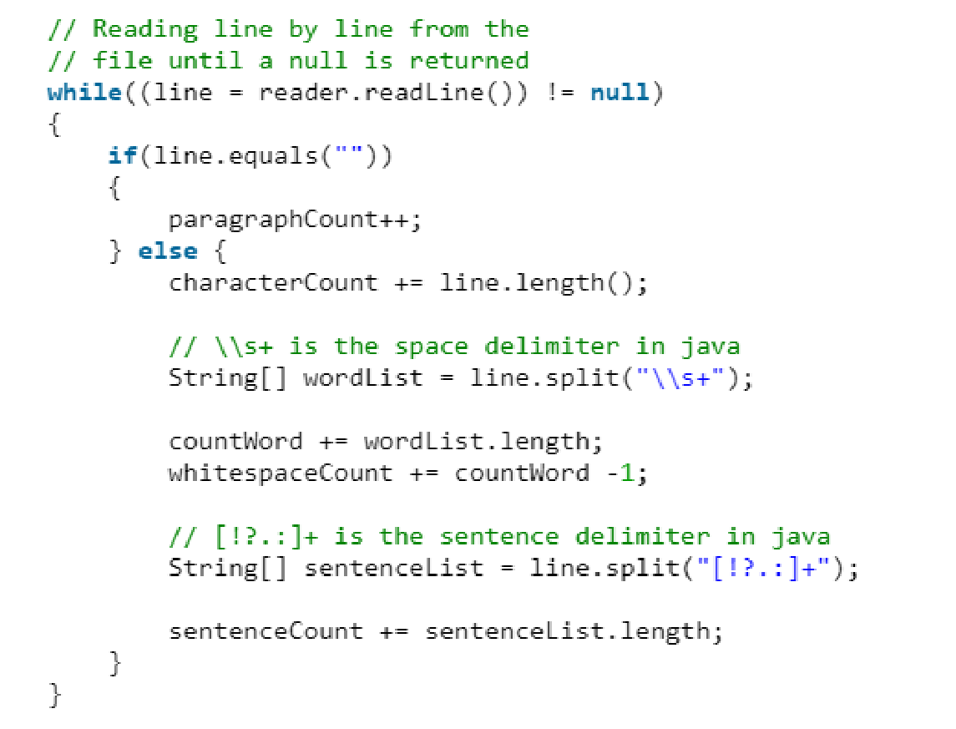
Example Task (cont..)

Slide 113
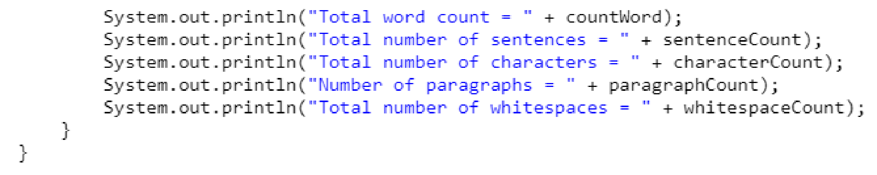
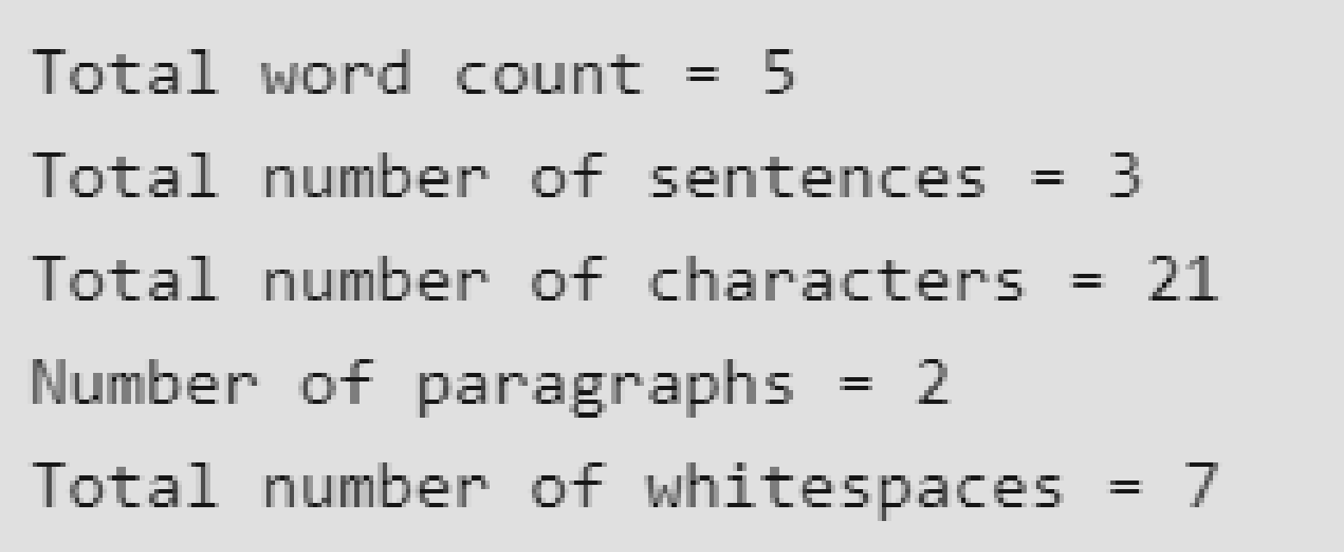
Example Task (cont..)

Slide 114
Thank You!!!

